Slide 1

SPSC APPLICATION
Sales Person Supply Chain Application

Slide 2

Origin of Concept
After 30 years in the Motor Industry mainly in Sales and having worked with numerous CRM systems, the one area, in my experience, that isn’t addressed by these systems and yet is fraught with pitfalls and problems, is the period of time between the closing of the deal and the car actually being delivered.
Regardless of whether the car is New or Used, or the Make or Model there is very little variation from the standard process.
Most Sales People are left to devise their own solution

Slide 3
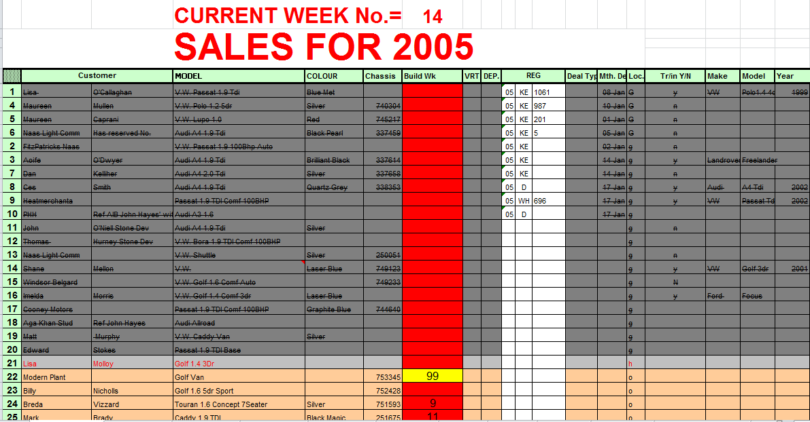
Current solutions include:
List in Diary
Kardex System
Ad Hoc
Spreadsheet

Slide 4
Sale to Delivery Process

Slide 5
SPSC SOLUTION
SPSC App
New Vehicles
SPSC App
Vehicle Sold
SPSC App
Used Vehicles
SOLD
SOLD
Reg No
ORDERED
SERVICED
PDI’D
Customer
BODY PREP’D
REG’D
NEW
NEW
USED
VALETED
VALETED
READY
CLEAN
READY
SVC’D
B/WRK
READY
DELIVERED
DELIVERED
DELIVERED

Slide 6
NUMBERS!

Slide 7
Future Potential
With an estimated Market yielding €12,000,000 per annum, a modest 10% penetration would offer 1.2 million turnover on this app alone.
Success of the SPSC App would offer further opportunities to expand the system to enable groups of Sales People to co-ordinate their activities and further improve efficiency and productivity for the Dealership.
Once proven, the SPSC App could be adapted to other ‘high-end’ retail sales operations such as Marine Sales, Plant/Machinery Sales and possibly Property/Real Estate Sales.

Slide 8
QUESTIONS?

